Slide 1
US Healthcare An overview

Slide 2
Revision History
Date | Revision | Description | Name | Reviewer
Dec 2008 | 0.1 | Initial document | HiteshK, SmritiP, SajanS
6/28/2009 | 0.2 | Review and compiled version | SurendraA, SubashD, PrameshV
11/03/2009 | 0.3 | Review and added other product basics other than D2E | SurendraA, RashmiP, NabinK
2/2/2010 | 0.4 | New information on delivery added, D2E specific content removed for coverage in D2E Training | SajanS
12/22/2010 | 1.0 | Current market and other slides modified | SurendraA | BinodB, JackieH

Slide 3
Facts and figures
U.S. (308 Million) spends more on health care per person any other nation in the world.
National health spending reached $2.5 trillion in 2009, accounting for 17.6 percent of the gross domestic product (GDP).
By 2018, national health care expenditures are expected to reach $4.4 trillion—more than double 2007 spending.
Medicare spending is projected to grow 8.1% in 2008 and average 7.3% per year over the projection period.
Medicaid spending is projected to grow 6.9% in 2008 and average 8.4% per year over the projection period.
Private spending is projected to grow 5.3% in 2008 and average 5.3% per year over the projection period.
SOURCE: WIKI

Slide 4
Facts and figures (contd.)
Ever rising Healthcare cost: $1,106 per person in 1980 ($255 billion overall 9% of GDP) to $8,116 per person in 2009 ($2.5 trillion overall 12.6% of GDP).
Uneven distribution across individuals, different segments of the population, specific diseases and payers:
5% of the population accounts for almost half (49 %) of total health care expenses.
The 15 most expensive health conditions account for 44 percent of total health care expenses.
Patients with multiple chronic conditions cost up to seven times as much as patients with only one chronic condition.
Universal health care believes that all citizens should have access to affordable, high-quality medical care. The United States is the only wealthy, industrialized nation that does not provide universal health care to all its citizens. (Watch SICKO – Michael Moore)
(This will change with new Healthcare reform laws)
The states regulate health care in three general ways:
setting and enforcing standards for health care organizations, professionals and the environment;
creating health programs or purchasing services for poor people; and
administering federal programs.
SOURCE: WIKI

Slide 5
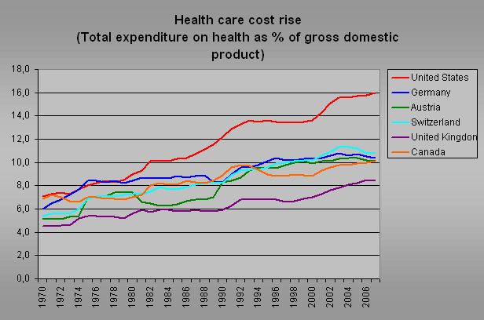
Source: Wiki

Slide 6
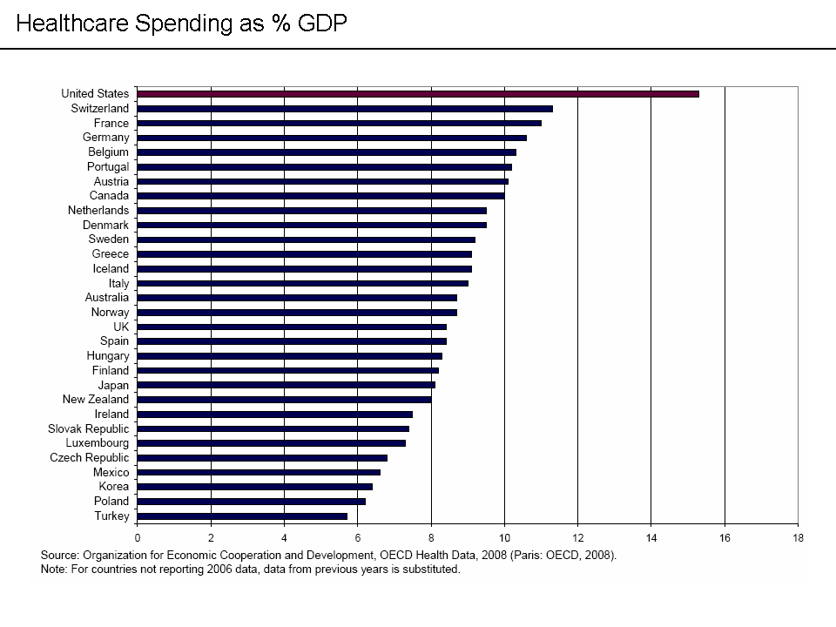
Source: Wiki
Notes:
U.S. healthcare costs exceed those of other countries, relative to the size of the economy or GDP

Slide 7
Healthcare USA
There are two key objectives of a health care delivery system:
To provide access and to deliver services that are cost-effective.
To meet pre-established standards of quality.
Health care
Is not delivered through a standard linear system, but instead through a kaleidoscope of financing, insurance, delivery, and payment
Mechanisms that are not standardized and are coordinately loosely.

Slide 8
Healthcare Delivery - functional components
Financing
to purchase insurance or to pay for health care services consumed
Insurance
to protect against catastrophic risk
Delivery
To provide health care services.
Payment
To reimburse providers for services rendered.

Slide 9
Healthcare in the US: Overview
In the US, ownership of the health care system is mainly in private hands, though federal, state, county, and city governments also own certain facilities.
Healthcare facilities are largely owned and operated by the private sector.
Health insurance is primarily provided by the private sector, with the exception of government-run programs (Medicare, Medicaid, TRICARE, CHIP, and the VA).
Examples of private sector insurance companies: Aetna, UnitedHealth Care, Cigna, Wellpoint, Blue Cross of Massachusetts, Humana.
Health insurance means people collectively pool their risk-- in this case the risk of incurring medical expenses. In each case, the covered groups or individuals pay a fee, premium to help protect themselves from unexpected health care expenses. Similar benefits paying for medical expenses may also be provided through social welfare programs funded by the government.

Slide 10
The Health Care Workforce
Employs approximately 10 million people
850,000 doctors
3,000, 000 nurses
168,000 dentists
208,000 pharmacists
700,000 administrators
300,000 physical therapy, occupational therapy, speech
5,810 hospitals
17,000 nursing homes
5,720 mental health hospitals
11,700 home health and hospice agencies
800 primary care programs (HIV, black lung, homeless, migrant workers…)
300 medical, dental and pharmacy schools
1,500 nursing programs

Slide 11
Healthcare Delivery
More numbers:
190 million Americans with private ins (42 BlueCrossBlueShield plans, 540 health maintenance organizations, 925 preferred provider organizations)
Note: BCBS is a type of Private insurance; HMO, PPOs are types of private plans and BCBS can be HMOs or PPOs or both
39.6 million Medicare beneficiaries
41.4 million Medicaid recipients
1,000 insurance companies

Slide 12
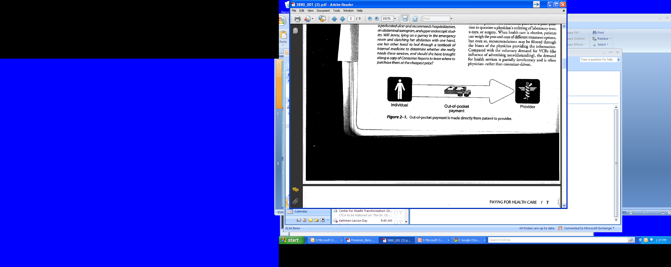


Ways of Paying for Healthcare in the US
There are four ways of paying for healthcare in the US
Out of Pocket Payment:Payment is directly made from patient to Provider
Individual Private Insurance (“Private Non Group”): A third party, the insurance plan (“health plan”), is added, dividing payment into a financing component and a reimbursement component.
Employer (“Group Insurance”)-Based Private Insurance: Employers pay some or all of health insurance premiums to the health plan on behalf of the employee.

Slide 13

Ways of Paying for Healthcare in the US (contd.)
4) Government Insurance: Government plans are funded by tax dollars and only certain individuals are allowed to receive benefits. Medicare and Medicaid are two types of government plans.

Slide 14


How Does Healthcare Work- I
Public Health Insurance
1) Federal Government
2) State Government
Medicare
Medicaid (Uninsured)
Medicaid is partly paid for by federal govt. plus partly by state

Slide 15
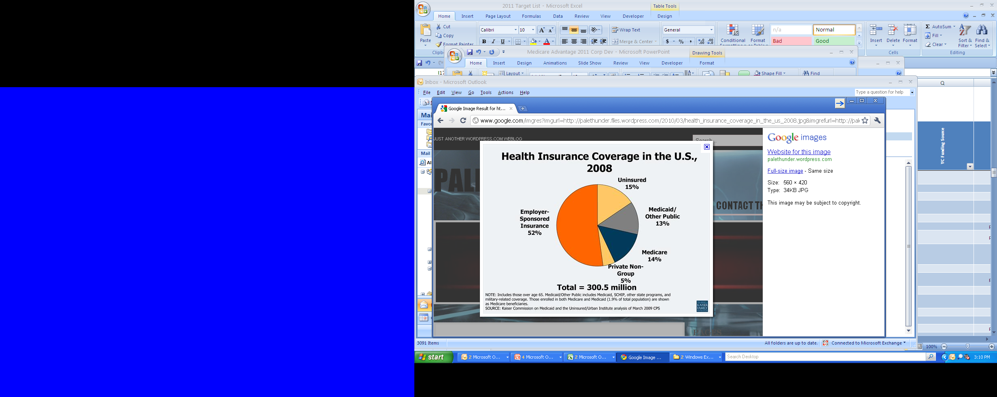

Slide 16
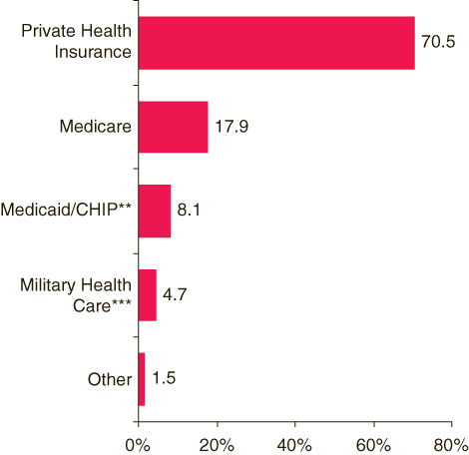
Health Care Cost Coverage

Slide 17
Healthcare in the U.S. Main Players and structure
Payers and Health Insurance
Commercial: self-insured vs. fully-insured
Physicians and other Providers
Consumers (patients) and Employers
Medicare
Medicaid
Primary care vs. specialists
Rural vs. urban
Reimbursement models
Transparency
Accountability
Financing
Pharma and Medical Devices
Reputation (deserved or not)
Innovation

Slide 18

How Does Healthcare Work - II
Private Health Insurance
Group (Employer)
Health Insurance
2) Individuals
Fully Insured
Self Insured
Individuals can buy health insurance directly from health insurance plan
Employers pay often pay for a part of their employee’s insurance

Slide 19
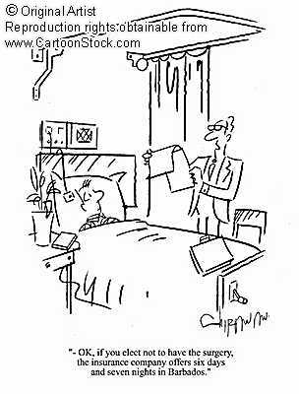

Slide 20
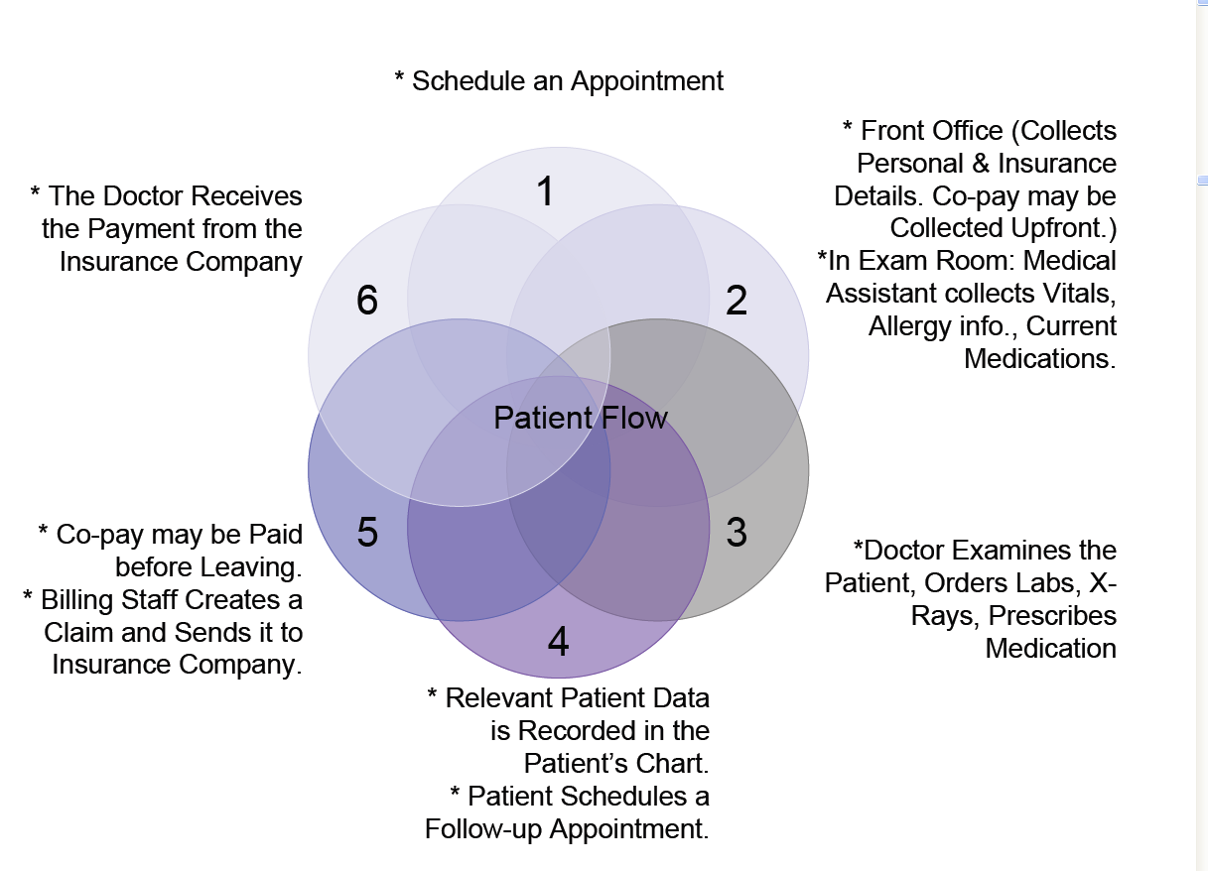

Slide 21






How Does Healthcare Work - III

Slide 22

Sample Insurance Cards
This should be supplied to get
any type of medical service
Health Insurance card front page
Health Insurance card back page

Slide 23


How is medical claim generated?
CMS 1500 Professional 1500
UB 92 Facility (Hospital, Nursing Home)

Slide 24

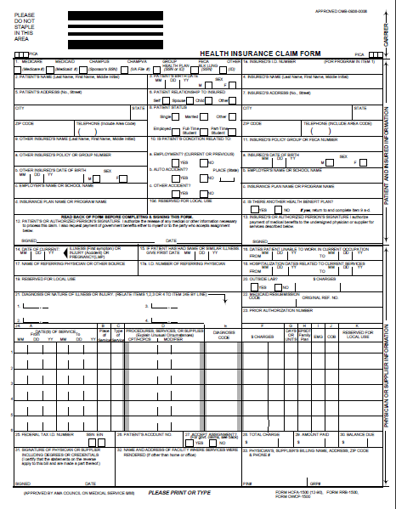
CMS 1500 and UB 92
UB 92
CMS 1500

Slide 25
Medical Claim Process

Slide 26
Adjudication process
The process used by health plans to determine the amount of benefit payment for a covered health care service. The term usually refers to the processing of a health care claim.
The process includes a review of whether the service is covered by the health plan and whether deductibles, co-insurance, co-payments or other benefit limits apply.
Claim | Billed amt (A) | Copay (B) | Invoice (C) = A-B | Allowed amt (D) | Disc: NW based in % of D (E) | Net amt (F) = D-B-E | Ins company
C1 | 175 | 25 | 150 | 120 | 30 | 120-36-25 | Tufts HP
C2 | 175 | 25 | 150 | 90 | 20 | 47 | BCBS
C3 | 175 | 0 | 175 | 50 | 10 | 45 | Medicare
C4 | 3500 |  |  | 2000 | 20 | 1600 | Hospitals for R&B
C5 | -3500 |  |  | -2000 | -20 | -1600 | Needed to correct
C6 | 3000 |  |  | 2500 | 30 | 1875
Notes:
See a complete sample of fields and figures.

Slide 27




How is Pharmacy Claims generated ?
RX Database
Notes:
PBM : Pharmacy benefit managers are only managing the Rx costs paying to Retailer for the timebeing and get reimburshment from insurance company or ASO or Govt etc.
HMO: It must needs referral from PCP
PPO : No need of referral, patient can directly visit without any referral

Slide 28
Pharmacy claim process
Patient
PCP
Pharmacy Retailer
Fill/ Dispense
Pay back to PBM
Show insurance card
Copay, Deductible applied
PBM/ Payer
PBM pays the amount to retailer and sends the file/ dates to Payor
Ins company
Govt
ASO
TPA
Employer
Retailer gives medicine to patient and sends record to PBM
Get medicine with dose note
Notes:
Change this slide:

Slide 29
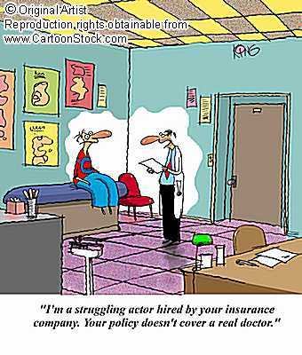
19-Nov-21

Slide 30
Types of Healthcare Plans
Indemnity Plan
Managed Care
Health Maintenance Organizations (HMOs)
Business arrangement between Doctors, hospitals, and insurers
medical treatment on a prepaid basis (flat rate each month)
Primary Care Physicians act as Medical Gatekeepers
they underwrite the risk of providing health care for a contract year (12 months).
Low out of pocket cost for individuals, focus on wellness and preventative care
Needs PCP referral
Preferred Provider Organizations (PPOs)/Point of Service (POS)
Organizations in which insurers contract with a limited number of physicians and hospitals (“in network”) who agree to care for patients, usually on a discounted Fee-for-service basis.
Members have their choice of healthcare provider, but often pay more for using providers that are not contracted with the insurance company. (In and out of network )
No Need of PCP referral

Slide 31
Our products
Sightlines Medical Intelligence (MI)
Sightlines Enterprise Analytics (EA)
DxCG Risk Solutions (DxCG)
Performance Measurement (PM)

Slide 32
Our Customers
Brokers and Consultants (Eg. Locton, AON, AdvisoryBoard, Mercer, IWS)
Health Plans (Eg. Blue Shield of California, Health Net, Tufts Health Plan, WellCare, Network HP, Community Care Partners)
Self-Funded Employer Groups (Eg. Walmart, Accenture, Shaw industries, MPTN, Smith Group of America), prospective for future.
CM, DM (Eg. HealthWays, Nurture, US Preventive, Pfizer Health,)
Physician Organizations/Provider Groups. (Eg. Mount Auburn, IPA, Atrius, JSA, CDPHP)
TPA (Eg. Coresource, Wells fargo, Web TPA, HPI).
State Governments (Prospective) (eg. State of Massachusetts)
Stop loss carriers (Eg Sunlife) .
PBM, ASO
Note: There are other players like hospitals , medical device companies, pharmaceutical companies in USHC but VH does not sell to these types of players (now).
19-Nov-21
Notes:
Break it in two a) first Products and give brief overview ( in addition to 4 major product we sell Extract and Warehouse as upsell and MEG and Clinical performance measurement as upsell.
b) Our customers
The Product flow is: Market need assessment / Prepare the product/ Sell to Client

Slide 33
Players in the market - I
Brokers and Consultants
Brokers and consultants advise companies that purchase health care coverage for their employees. Not all companies employ consultants to assist them. Brokers and consultants earn their revenue by getting a commission on the final sale of the selected coverage the client purchases, whether health plans or self-funded.
Market Profile
Current Clients: AON, Lockton,
Competitors: Ingenix, Zywave, Thomson (Medstat)
Products sold: MI, DxCG, EA, MEG, Extract

Slide 34
Players in the market - II
Health Plans
Health plans are referred to as Full Indemnity, Health Maintenance Organizations (HMO) etc. The distinguishing feature is that they underwrite the risk of providing health care for a contract year (12 months). They are paid a flat rate each month; in return, they pay all of the claims after subtracting the amount the members themselves pay.
Market Profile
Current Clients: Network Health Plan, WellCare, Blue Cross at MA, Health Net, Community Care Partners)
Competitors: MedAi, ViPs, Outcomes, MedAssurant, Thomson (Medstat), Ingenix
Products sold: DxCG, EA, PM and some use MI

Slide 35
Players in the market - III
Self-Funded Employer Groups
Self-funded Employers is when an employer provides health insurance to employees with its own funds and becomes financially liable for all the medical claim costs of their employees.
This is different from fully insured plans where the employer contracts an insurance company to cover the employees. In self-funded health care, the employer assumes the direct risk for payment of the claims for benefits.
Clients select to be self-funded for many reasons, such as they have healthy employees, they don’t want to pay for the state mandated items with full indemnity plans, or want their own choice of network.
Self-funded groups negotiate better rates with providers, networks, and stop loss carriers.
Self-funded employers often use Care/Disease Management programs to keep members healthy.
Market Profile
Current Clients: WalMart, Accenture, Shaw Industries, MPTN, Smiths Group
Competitors: Thomson (Medstat), Ingenix, HealthSpring, HDMS
Products sold: MI, EA and some has DxCG

Slide 36
Players in the market - IV
Care Management (CM)/ Disease Management (DM) Organizations
Care management and disease management organizations manage individual members to ensure appropriate care is received for particular cases while managing health care expenditures (CM) and to ensure entire populations susceptible to a particular disease are managing their health conditions (DM). Care Managers look at individual cases and coordinate services for that person. Disease Managers look at population groups that are afflicted with or are susceptible to certain diseases. Both focus on proactive measures and thus check healthcare costs by acting before it is too late. Health plans and employers typically hire these companies to help keep their members healthy.
Market Profile
Current Clients: Healthways, Pfizer
Competitors: MedAi, homegrown systems, Ingenix, HealthDialog
Products sold: MI and DxCG

Slide 37
Players in the market – V
Physician Organizations/Provider Groups
Physician organizations and provider groups are groups of physicians or health care providers who are financially responsible for the total care and treatment of their patients regardless of whether they themselves or unaffiliated physicians provide the care.
Market Profile
Current Clients: JSA, Atrius
Competitors: Thomson (Medstat), Ingenix, MEDai, Medventive
Products sold: MI and DxCG
19-Nov-21

Slide 38
Players in the market – VI
Third Party Administrators (TPA)
Third Party Administrators pay claims on behalf of self-funded clients. They have a financial incentive to improve the performance of the health plan or risk losing their customer base. Because TPAs have to satisfy the demands of brokers and consultants and self-funded groups, they are constantly on the look out for potential cost savings opportunities, such as changes in networks and benefit design. TPAs may provide CM/DM services also.
Market Profile
Current Clients: Wells Fargo, CBSA, UMR, Kanawha, etc.
Competitors: Zywave, Thomson (Medstat), Benefit Informatics
Products sold: MI

Slide 39
Players in the market - VII
Stop-Loss Carriers (or Re-Insurance Groups)
Stop-loss carriers serve self-funded clients by mitigating the risk which arises due to a few individuals with extremely high health care costs. In specific coverage, the self-funded group pays all the claims for each individual until an individual’s total claims costs become greater than the threshold limit. The limit can be as low as $20,000 or go up to millions of dollars. In aggregate coverage, the self-funded group pays all the claim costs until the total claim cost for all individuals covered reaches the threshold. All types of medical plans (self-funded, fully insured etc.) use stop-loss insurance.
Market Profile
Current Clients: SunLife, Genworth
Competitors: Thomson (Medstat)
Products sold: MI and DxCG

Slide 40
Players in the market - VIII
Pharmacy Benefit Managers (PBM)
Pharmacy benefit managers (PBMs) manage the payment and reporting of all prescription drugs not administered in an inpatient setting and some special purpose outpatient drugs (chemotherapy given in a physician’s office or injected drugs administered at home). They design the formularies, negotiate with the pharmacy vendors, pay the claims, and identify potential drug interaction issues. (Caremark)
Market Profile
Current Clients: None
PBMs are hired to help payer control costs.
30 PBMs in the marketplace and consolidating, D2 receives data feed from most of them

Slide 41
Players in the market - IX
State Governments
Responsible for setting and enforcing standards for health care for
organizations, professionals, and the environment
creating health programs or purchasing services for poor people;
administering federal programs.
Market Profile:
Current Clients: State of MA
Products sold: DxCG and sometimes MI

Slide 42
Players in the market - Cont….
Government plans for
Medicaid
Provides medical assistance for certain individuals and families with low incomes, Jointly funded by federal and state governments.
Available to people of <65 and eligibility is based on financial need.
Medicaid recipients do not pay a premium for the health care coverage.
Medicare
Provides health care coverage for people> 65 years and some disabled people.
Income is not taken into account for coverage.
Eligibility requirements for this program are the same from state to state.
Members pay a small premium as well as co-payments for services.
Medicare Advantage
Anyone on medicate can sign up for Medicare Advantage. It allows Medicare users to receive coverage through a private health plan. It costs extra but has better coverage.

Slide 43
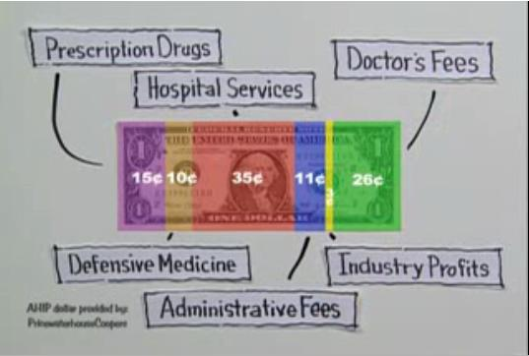

Slide 44
End of part I

Slide 45
Measure, Manage, Mitigate
Verisk Health leverages healthcare data to identify, measure, manage and reduce medical and financial risk – at both the patient and population levels.
With Verisk Health, our clients now have market-leading clinical, predictive and financial analytics, along with large benchmark datasets and a flexible technology platform.
This powerful combination sets us apart from our competitors, as does our commitment to analytic neutrality and customer service.

Slide 46
Analytics Framework
Optimize
Risk
Management
Better Data
Better Analytics
Better Decision Support
11+M individuals in research database and growing
6+ M lives in the normative database
DxCG – global standard in predictive analytics
MI -- market-leading clinical ‘engine’ and tools to identify and reduce risk
PM – HEDIS reporting and analysis
EA and MI– leading ASP analytics and decision support platforms

Slide 47
Percent of Revenue by Segment (Excludes International and D2IT)

Slide 48
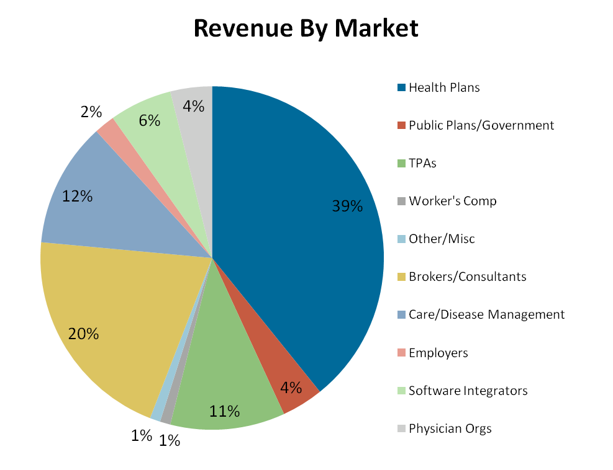
Market Reach
Source: Verisk Health 2009 Account Data

Slide 49














Representative Clients

Slide 50
Product Portfolio
Value-add Services
Technical, Clinical and Analytical
ASP and Installed Software
Views into the data, depending on user type
Online analytics and role-based dashboards
Executive reporting and scheduled distribution
Risk stratification and cohort tracking
End-to-end HEDIS and quality measurement solution
Enterprise Software
Medical Intelligence
Enterprise Analytics (Health Intelligence Platform )
DxCG Risk Solutions
Performance Measurement
Consulting Services
Client Data Marts
Historic and rolling data
Direct Access to tables
Third Party System Integrations
API
Web Services
Custom data extracts
Data extracts, storage and normalization
Normative Database
Benchmarks
Data Transformation and Analytics
Business Intelligence Engine
Gaps in care
Risk adjustment, financial analytics and predictive solutions
Custom rules and OLAP cubes
Performance Measurement (TierMed) Engine
Data Aggregation and Warehousing
Data Aggregation and Cleansing
Automated data acquisition ~160 “pipes” built to payers (TPAs, PBMs, Health Plans)
Detailed scrub and QC
High-speed incremental loading

Slide 51
DxCG Risk Solutions (DxCG) Suite A robust suite of products proven to analyze, predict, manage and minimize healthcare risk
Chosen by CMS and the governments of Germany, Chile and Abu Dhabi to strategically allocate healthcare funding.
Capabilities include:
Predictive accuracy across multiple applications.
Best-in-class predictive modeling technology combined with advanced analytics to manage risk, improve health outcomes, and containing costs.
Clinical transparency models founded on straight-forward and easy-to-understand clinical principles.
Developed by physician experts and empirical analysis using a nationally representative database

Slide 52
How DxCG Risk Solutions Works
What it does
Groups diagnosis codes into medical condition classes using a classification system
How it is used
Presents a comprehensive clinical profile of an individual or group
Creates disease identification criteria for selecting individuals for a care management program, or disease registry
Measures the illness burden of individuals
Applies models to data to produce output
Passes output to one of our canned reports, to a 3rd party reporting system, workflow application, or a VH product

Slide 53
Medical Intelligence (MI) Suite Clinical and benchmark capabilities with world-class analytics
Capabilities include:
Detection of high risk members or groups using proven predictive models.
Clinically sound quality and risk measures to pinpoint opportunities to improve care and reduce costs at both the individual and population levels.
Executive dash-boarding and employer reporting
Data importing and reporting tools to leverage HRA and disability data and gain insight on total health and productivity measures.
Tools to compare various health and pharmacy plan alternatives and visualize the financial impact of plan changes on future costs and coverage.
Identify, measure, manage and reduce financial and clinical risk – at the population and individual level

Slide 54
Turning Data into Knowledge into Action
Medical Intelligence Key Features & Functions
Pharmacy Claims Data
Case Management Data
Virtual Medical Record for All Eligible Members
VMR Office Visits All Rx All Hospital All X-ray All Rad. All Lab All Costs All Proc. All Diag. All Specialty All Claims All Costs
Case Management
HRA Data
D2
Eligibility Data
Medical Claims Data
Disease Management
Understand Risk
Pinpoint Cost Control Opportunities
Increase Quality of Care
Results:
Notes:
Mention HRA (health risks assessment) and Biometrics data

Slide 55
Why do clients buy Medical Intelligence?
To proactively identify opportunities to improve individual health and healthcare quality, and continue to positively impact health benefit and reduce costs across the managed population.
To help identify the high-risk, potential high-cost members prior to beginning the outreach workflow.
To identify, measure, manage and reduce financial and clinical risk – at the population and individual level
To demonstrate service excellence and value to their clients
To make need-based decisions about deploying medical management resources
To outsource data aggregation capabilities

Slide 56
How does Medical Intelligence deliver value?
By feeding care managers only those patients that fit a pre-determined profile (consistent with a cost containment and improvement in care strategy).
By prioritizing members by risk, so that care managers focus resources first on those where they can have the greatest impact on health status.
By helping to intervening on potential high-cost patients today will contain client costs tomorrow.
By producing clinical and financial scorecards for each member for use by providers and members.
By providing custom letters for members and providers.
By profiling providers by clinical outcomes and guideline compliance.
By providing clients with easy and reliable reporting

Slide 57
Overview: Who Buys Medical Intelligence?
Segment | Primary Use/Goals
Brokers/Benefit Consultants | Reporting, Benefit design, financial risk identification
Third Party Admin (TPA) | Reporting, Care Management, Demonstrate Service excellence, cost control
Re Insurers | Reporting, financial risk identification, pass thru as value-add software for its Care Management clients
Disease Management Co | Care Management, Demonstrate Service excellence, cost control, reporting
Health Plans | Support Care management arm of the health plan when done in house
Employers | Reporting, Care Management, Improve wellness of Employees, Improve Employee productivity, cost control, reduction in lost productivity
Providers | Care Management/Intervention, Quality Improvement, Demonstrate Service excellence to patients and to payers, cost control for at risk groups
Buyer’s key goal
Client is looking for an easy to use, web based reporting tool to support the medical management outreach activities of clinical staff in an effort to control costs and improve care delivery

Slide 58
Enterprise Analytics (EA) Suite A highly scalable, secure web-based healthcare claims analysis and reporting environment
Capabilities include:
Data acquisition and warehousing
Executive Summary drill down and customizable business intelligence layer
Client reporting interface
Web-based drillable analytics and real-time glossy reports
Support of a full range of best-in-class DxCG predictive models
Rapid data transformation, loading and presentation
Integrates online analytics, executive reporting, and custom dashboards through a single interface.
Integrates data from many sources into a common warehouse to deliver consistent, accurate results.

Slide 59
Conceptual Diagram: Enterprise Analytics
Business Intelligence Suite
Raw Data
USTART: ETL
End Users:
Client Portal
UWg, Actuarial, HCE
DCGs
DRGs
FLAG
EClare
ETGs
Espresso
Account Managers
Employer Groups
Care Management
Viewer
Medical Director/Provider Relations => Providers
Rules Engine
Quality Measures Cube
3rd Party Portal
Case Managers
Patient/Members
Notes:
Goal to create one brain that creates prioritized and consistent messages at every touch point.
59

Slide 60
Why do clients buy Enterprise Analytics?
Cost Containment
Standardization of internal metrics & portability of technology across departments
Aggregate, cross departmental reporting views to inform better business decisions and to gauge progress and efficiency
Demonstration of service excellence and value to their clients
Connect the healthcare community internally and externally
Quality Measurement
Very fast data refreshes
Common Buyer Goal
To create one source of truth that creates prioritized and consistent messages at every touch point.

Slide 61
Performance Measurement (PM) Suite Industry-leading toolset for developing and integrating HEDIS® software.
Capabilities include:
Ability to analyze claims data, enter medical record data and submit data to NCQA quickly and easily.
Ability to view, query, analyze, and measure HEDIS data using standard or custom specifications, filters or drills.
Tools to calculate HEDIS measures quickly and accurately using fully NCQA-certified software.
Ability to collect HEDIS administrative and hybrid medical record data quickly and easily.
Secure, web-enabled software that facilitates the communication, planning, and managing of projects and checkpoints related to HEDIS measure production.
Achieve 100%
Compliance for health procedures
among your members.
View results in real-time for each HEDIS measure, sample, and chase calculation
performed.

Slide 62
Performance Measurement: What is HEDIS?
HEDIS = Healthcare Effectiveness Data and Information Set
Name recently changed (July 2007), was ‘Health Plan Employer Data Set’
Created in 1993 by National Committee for Quality Assurance [NCQA]
Used by more than 90% of HPs to measure performance
Consists of 71 measures across 8 domains of care
Examples of HEDIS Measures:
Asthma Medication Use
Controlling High Blood Pressure
Cancer Screening
Notes:
Name Changed to reflect a broader scope and utility---represents trend toward quality measures
Altogether, HEDIS consists of 71 measures across the following 8 domains of care:
Effectiveness of Care
Access/Availability of Care
Satisfaction With the Experience of Care
Health Plan Stability
Use of Services
Cost of Care
Informed Choices
Health Plan Descriptive Information.

Slide 63
Who Buys Performance Measurement (HEDIS Reporting)
Primary Market: Health Plans that are required to file HEDIS
Medicare Advantage Plans
Special Needs Plans
Commercial HMOs
Medicaid
Secondary Market: Health Plans and other players that are not required to file HEDIS but do so for marketing purposes or as a way to measure success of quality initatives
PPOs
Other non-mandated HPs, State contracts QIOs
IPAs
Marketing, P4P transparency, Medical Home, patient targeting
Channels : EHRS, Portals, Wellness, Employers, DM Companies, TPAs
Hospitals, rural health clinics etc.
Notes:
HMO (Health maintenance organization). An organized health care system that is accountable for both the financing and delivery of a broad range of comprehensive health services to an enrolled population.
An HMO is accountable for assessing access and ensuring quality and appropriate care. Practitioners affiliated with the health care system render health care services. In this type of organization, members must obtain all services from affiliated practitioners and must usually comply with a predefined authorization system to receive reimbursement. A practitioner is a professional who provides health care services and is usually required to be licensed as defined by law.
POS (Point of service). An HMO with an opt-out option. In this type of organization, members may choose to receive services either within the organization’s health care system (e.g., an in-network practitioner) or outside the organization’s health care delivery system (e.g., an out-of-network practitioner).
PPO (Preferred provider organization). PPOs take responsibility for providing health benefits-related services to covered individuals and for managing a practitioner network. They may administer health benefits programs for employers, either by assuming insurance risk or by providing only administrative services

Slide 64


Verisk Health Snapshots
Finding answers to the hardest questions…
Who are my highest users of health care resources?
Who will emerge as the highest users of resources in the future?
Which providers are doing the best job of managing risk in my population?
Which providers are doing the most efficient job of managing care?
Q
How are my health care dollars being spent?
How do I quantify risk?
How effectively are my current health care solutions performing to improve care and reduce cost?
Who in my population is at risk because of the quality of care they are getting?
Quality
Notes:
64
64

Slide 65
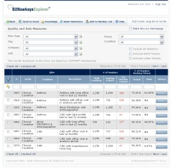



Products and Services Positioning
How Customers use VH solutions?
Analyze, stratify and group Consumers by risk & disease type
Clinical Users
Financial Users
Drill-down to Consumer’s record to intervene to improve his/her care
Strategic Users
Evaluate Care Quality and monitor for existing and potential adverse events in large populations
Consumers
+
+
=

Slide 66
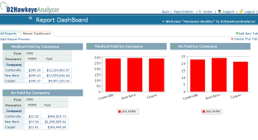
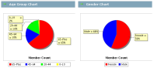



Products and Services Positioning
How Customers use VH solutions?
Aggregate complex information into simple, informative views
Discover key drivers of Medical and Pharmacy cost. Predict financial exposure and risk.
Maximize revenue opportunities from Customers and other sources
Clinical Users
Financial Users
Strategic Users
Consumers
Benefit maximization
Notes:
66

Slide 67
Products and Services Positioning
How Customers use VH solutions?
Plan new Financial and Medical Risk Management Strategies
Design Benefit Plans to better serve my Consumers, and incentives for Vendors, Providers and Consumers
Share information strategically across my Enterprise
Clinical Users
Carve-out
Case Management
Financial Users
Special Reinsurance Group
Strategic Users
P4P
HSA
CDHP
Consumers
Interactive Portals
Data Marts
Reports
Notes:
67

Slide 68





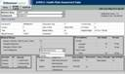
Products and Services Positioning
How Customers use VH solutions?
Provide Answers to Consumers’ Basic Questions:
Clinical Users
Financial Users
What were my medical and drug costs last year?
When did I last see Dr. Jones?
What drug was my daughter taking?
How much money should I save for health insurance?
Strategic Users
Capture Consumer perception of Health: Health Risk Assessment
Consumers
Notes:
68

Slide 69
End of Part II

Slide 70
Our Focus is Risk
Enterprise Risk Management to Reduce Costs and Improve Quality of Care
Financial Risk Solutions
Premium Setting
Underwriting
Cost & Utilization reporting
Risk Adjustment
High-cost Case Identification For…
Risk Pool Assessment
Reserve Setting
Stop-Loss
Re-Insurance
Clinical Risk Solutions
Identification
Stratification
Predictive event modeling
Gaps in care measurement
Trending & Reporting For…
Medical Management
Care Management
Cohort Management
Population Mgmt.
Performance Risk Solutions
Quality Reporting
Employer Reporting
HEDIS Reporting
Gaps in care Reporting For…
Regulatory Reporting
Provider Network Mgmt.
Client Account Mgmt. & Sales
Internal Operations
Pay-for-Performance
Benchmarking & Reporting
Data Management & Aggregation

Slide 71
What we do
Data Sources
Data Preparation
Medical Intelligence & Predictive Models
Medical Claims
Aggregation
Scrubbing
Normalization
D2Hawkeye
Rules Library
Pharmacy Claims
Eligibility
Consumer Health Risk Assessments
Other Data
Secure Data Bases
Normative Data
Virtual Medical Record
Reporting Tools
Stratifier

Slide 72
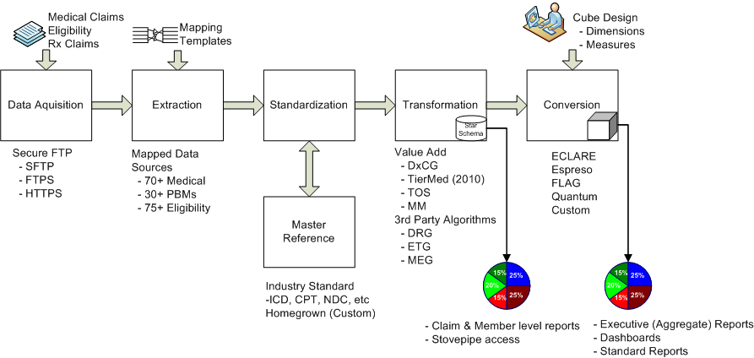
Data Aggregation Process Overview

Slide 73
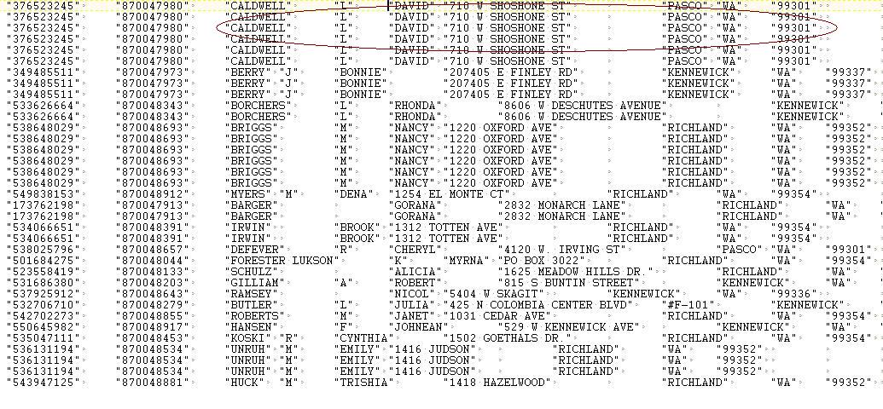
Raw files from client
Ref: Claims File

Slide 74
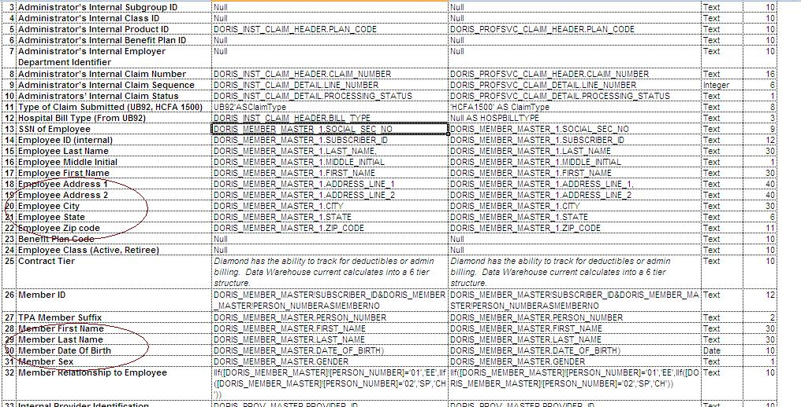
Data Dictionary and Layout
Ref: Layout

Slide 75
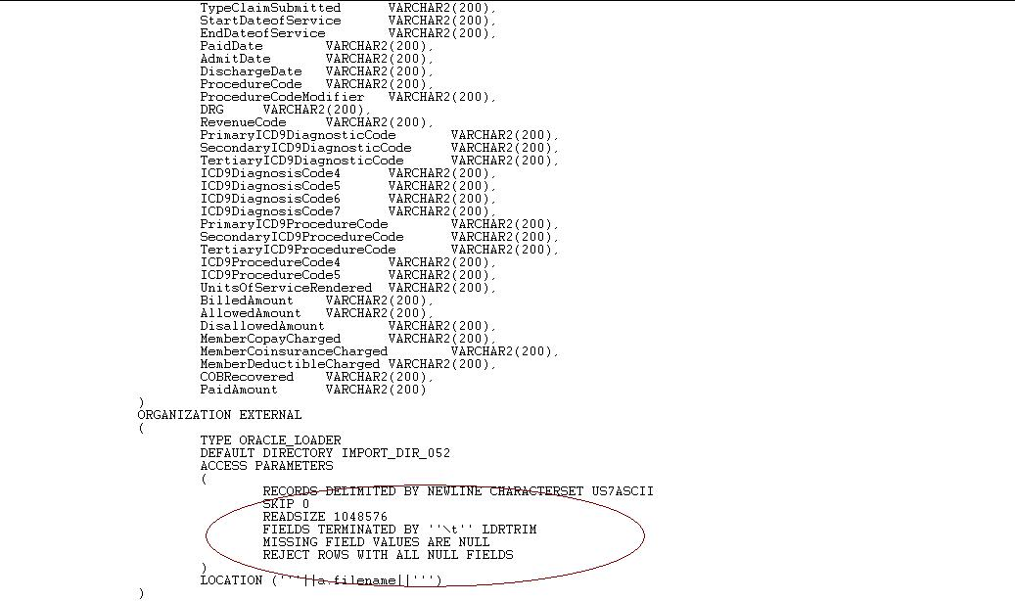
Import Script Preparation -I

Slide 76
Terms and Terminologies I
ASO (Administrative Services Only) : An arrangement whereby an insurer agrees to provide services to a self-insured entity, such as providing printed claim forms, and processing and auditing claims. The insurer does not assume any insurance risk under an ASO arrangement. TPA who don’t provide CM/DM services are ASO organizations
COBRA (Consolidated Omnibus Budget Reconciliation Act)
Federal act: which requires each group health plan to allow employees and certain dependents to continue their group coverage for a stated period of time following a qualifying event that causes the loss of group health coverage.
Qualifying events include reduced work hours, death or divorce of a covered employee, and termination of employment.

Slide 77
Terms and terminologies II
Member Month: is defined as the number of months members are eligible in a plan within a given cycle period. The calculation is based on effective and termination dates provided in eligibility data within the cycle period. The following calculation applies to member months:
If a member is eligible in a month, one member month is counted for that member for that month.
The total number of member months for a member is the sum of the member months for all months within the cycle period for which the member is in eligibility.
The total number of member months for a plan is then the sum of member months for all members.

Slide 78
Terms and terminologies III
Place of Service : This field specifies what location or type of environment where the service is provided. For example it can be office, inpatient, outpatient etc each represented by a particular standard code. Often the codes provided in the source may not comply with that of the industry standard codes and hence an intermediate rules table is prepared to map the source codes with the standard codes, better known as HCFAPOSCode.

Slide 79
Terms and terminologies IV
Procedure Codes: It defines the code for medical procedure performed. Typical standards are as follows: CPT-4, HCPCS, Revenue codes, ICD-9 Procedure Codes and DRG codes. Homegrown codes may exist and must be converted into D2Hawkeye standard to ensure accuracy in reporting. CPT-4 is in 5 digits, Revenue is three digit numeric codes. It needs to be preceded by “R”. The purpose of this code is to tell as to exactly what kind of operations/checkups were conducted on the patient. Possible source fields are i.e. CPT-4Code, RevenueCode, DRGCode, ServiceCode,
[COVERCODE01], ProcCode, ICD9ProcCode, SurgicalCode etc.
This industry standard field (ICD-9) defines the health problems (diseases) associated with the specific claim. The purpose of this code is to tell as to exactly with which disease the patient was diagnosed. Once a patient is diagnosed, further procedure(s) will be taken as action for remedy of the same.
Reference: http://www.planforyourhealth.com/resources.dyn/glossary.html

Slide 80
PMPM Calculation
Suppose there are 10 Members (In a Group or Complete plan Type). Each Member remain in the plan and paid for their benefit as under:
What we see from the table above is that PMPM for a member may be zero even
if he/she has been in the plan for a certain period. That’s how the risk is distributed.
WE ALL CAN NOT BE SICK AT THE SAME TIME.
Notes:
For a minute, I think it is helpful to summarize a few things that help distinguish D2Hawkeye as a company… four things that we can point at and say, “these are the things that make D2Hawkeye unique in the market”…
First, we are expert at building, normalizing, scrubbing and managing complex databases from disparate data sources.
Our physician advisory group has developed and maintains an extensive clinical rules and healthcare metrics library that is unique in our industry
D2Hawkeye provides a technology platform that optimizes medical analytics
We are expert at the application of statistical data analysis to our data models and to help validate our clinical rules library

Slide 81
Verisk Health Solution Roadmap
TierMed HEDIS rule integration
PCP reimbursement
Physician profiling
Disability/Work Comp integration
Advanced reporting
Risk Models into VHIP
Risk Models into Explorer
Quality measure engine
International analytics
Health and Wellness
Care Management expansion
Fraud & Abuse
Advanced clinical measures
ICD 10
Member specific reports
Q1 2010
Q4 2010
Q1
2011
Q4
2011
Q1
2012
New Quality and Risk Measures

Slide 82
Thank you

